Slide 1


FITEC
Automatic Classification of Plutonic Rocks with Machine Learning Applied to Extracted Shades and Colors on iOS Devices
Sarah Hernández Serrano
Asesor: Dr. Germán Harvey Alférez Salinas
Asesores secundarios: Dr. Benjamin L. Clausen y Dra. Ana María Martínez Ardila
00 de abril de 2021
UNIVERSIDAD DE MONTEMORELOS
FACULTAD DE INGENIERÍA Y TECNOLOGÍA

Slide 2




TABLE OF CONTENTS
Introduction
TABLE OF CONTENTS
Theoretical Foundation
TABLE OF CONTENTS
Results
Conclusions & Future Work

Slide 3

Introduction
Background
Problem Statement
Justification
Objectives
Hypothesis

Slide 4
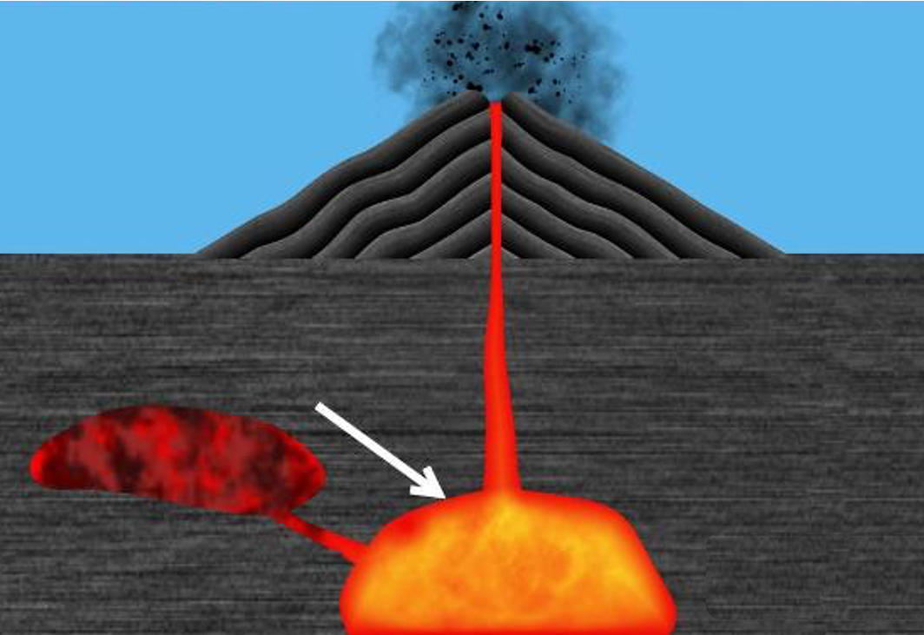
Introduction
Background
Plutonic rocks are formed when magma cools and solidifies below the Earth’s surface.
Lightness and color are properties used for the classification of plutonic rocks.

Slide 5
Introduction
Problem Statement
The instruments for accurate rock classification are expensive making it prohibitive for geology students and amateurs.
There is a lack of mobile tools for plutonic rock classification using machine learning.

Slide 6
Introduction
An iOS mobile application that classifies plutonic rocks with machine learning using their dominant colors does not exist. It offers the flexibility to carry out the classification in real time.
Justification
Verify if this approach with dominant colors leads to better results than the obtained in our previous work [ref].

Slide 7
Introduction
Extract dominant colors from plutonic rock images to train several machine learning algorithms and deploy the best model in an iOS application.
Objectives
Extract colors
Train the models
Validate
Compare
Determine the best number of clusters to use in K-means.
Extract the dominant colors of 283 images of plutonic rocks
Use the extracted dominant colors to train the following machine learning algorithms: LR, KNN, DT, SVM, and CNN.
Validate the models and deploy the best model in an iOS mobile application.
Compare the best model results with the obtained in our previous work

Slide 8
Introduction
Hypothesis
A machine learning model trained with just the dominant colors extracted from gabbro, diorite, granodiorite, and granite images can provide an effective way to classify these plutonic rocks.

Slide 9

Theoretical Foundation
Underpinnings of our Approach
Related Work

Slide 10
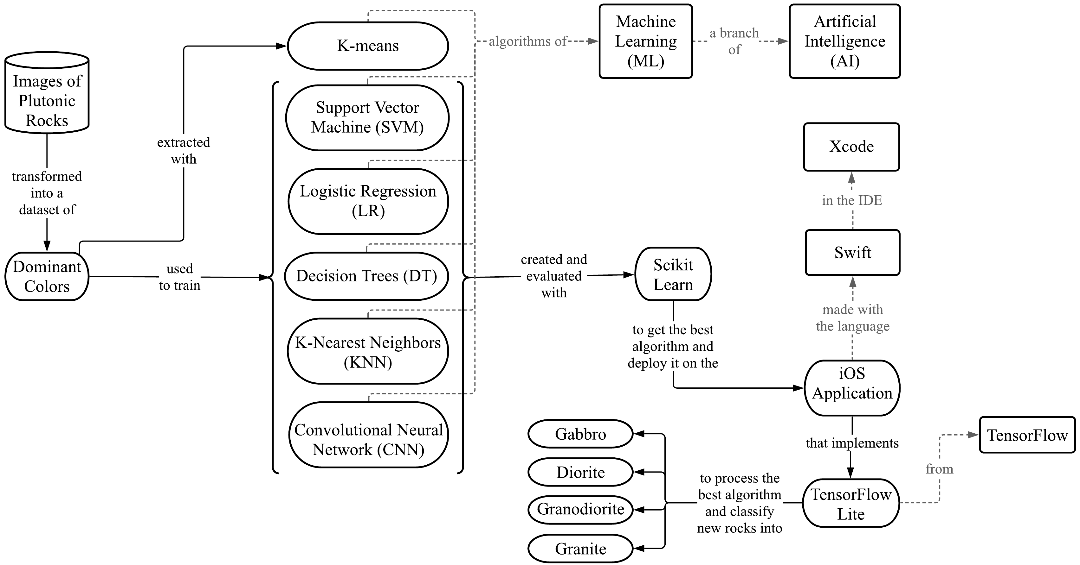
Theoretical Foundation
Figure 1. Underpinnings of our Approach

Slide 11
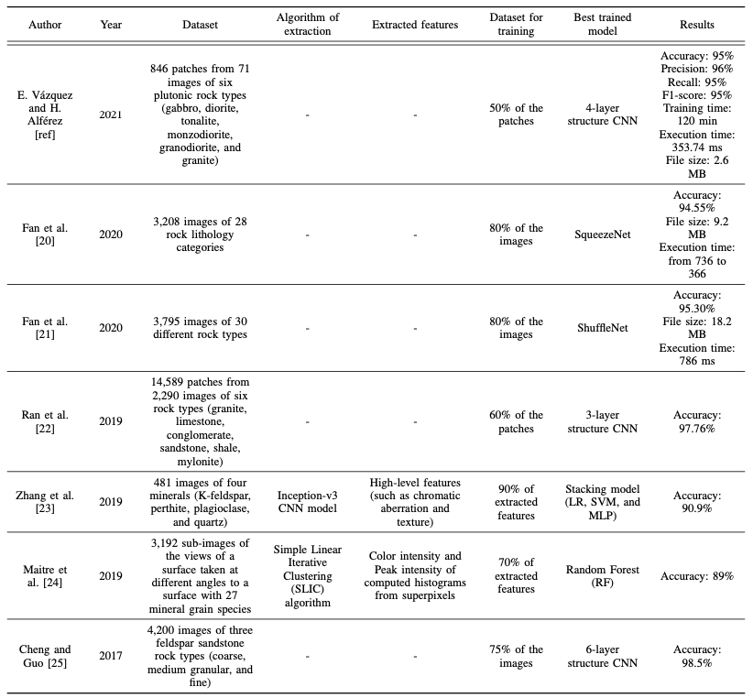
Theoretical Foundation
Related Work
Table 1. Comparison Table of the articles described in the related work

Slide 12

Results
Methodology
Results
Discussion

Slide 13
Results
Getting the images of the plutonic rocks
Preparing the data
Determining the best number of color clusters
Color extraction
Data normalization and label encoding
Training the different algorithms with the extracted dominant colors
Creation of the iOS application
Methodology

Slide 14

Results - Methodology
1. Getting the images of the plutonic rocks
The images of plutonic rocks were provided by the Department of Earth and Biological Sciences at Loma Linda University. We use pictures from plutonic rocks that were classified by using petrography and chemistry data.
Class | Number of images
Gabbro | 65
Diorite | 78
Granodiorite | 70
Granite | 70
Total | 283

Slide 15

Results - Methodology
2. Preparing data
In this step, the images were processed in order to obtain the color values of the image pixels in RGB and CIELAB color spaces.

Slide 16

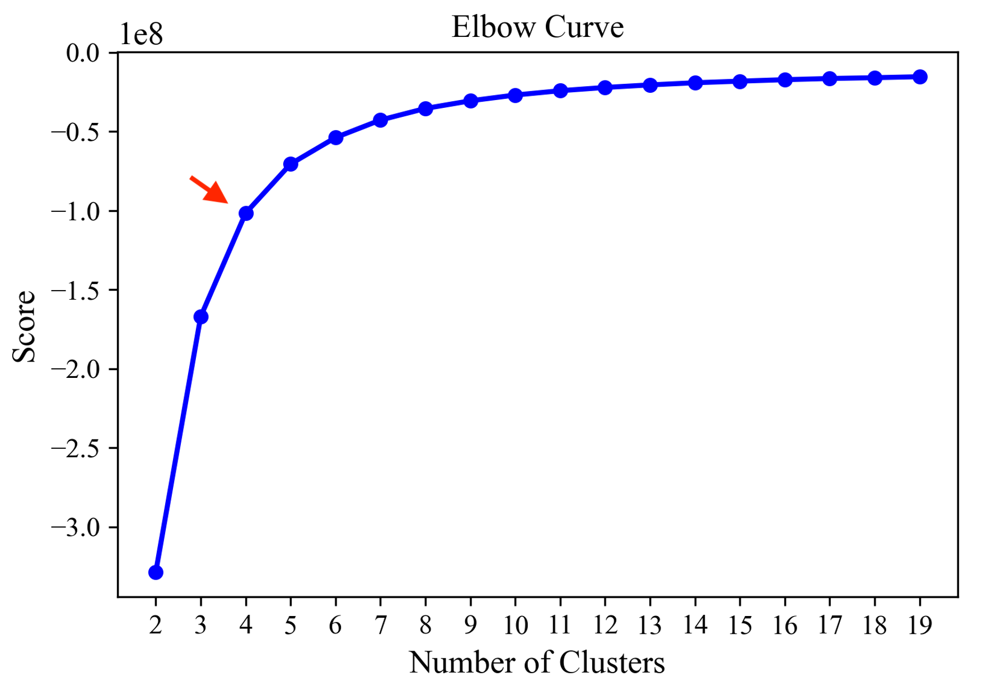
Results - Methodology
3. Determining the best number of color clusters
The Elbow method was used to calculate the optimal number of clusters to use in K-means.
The number at the elbow in the plot indicates the best k number of clusters, which is 4 for this experiment.

Slide 17
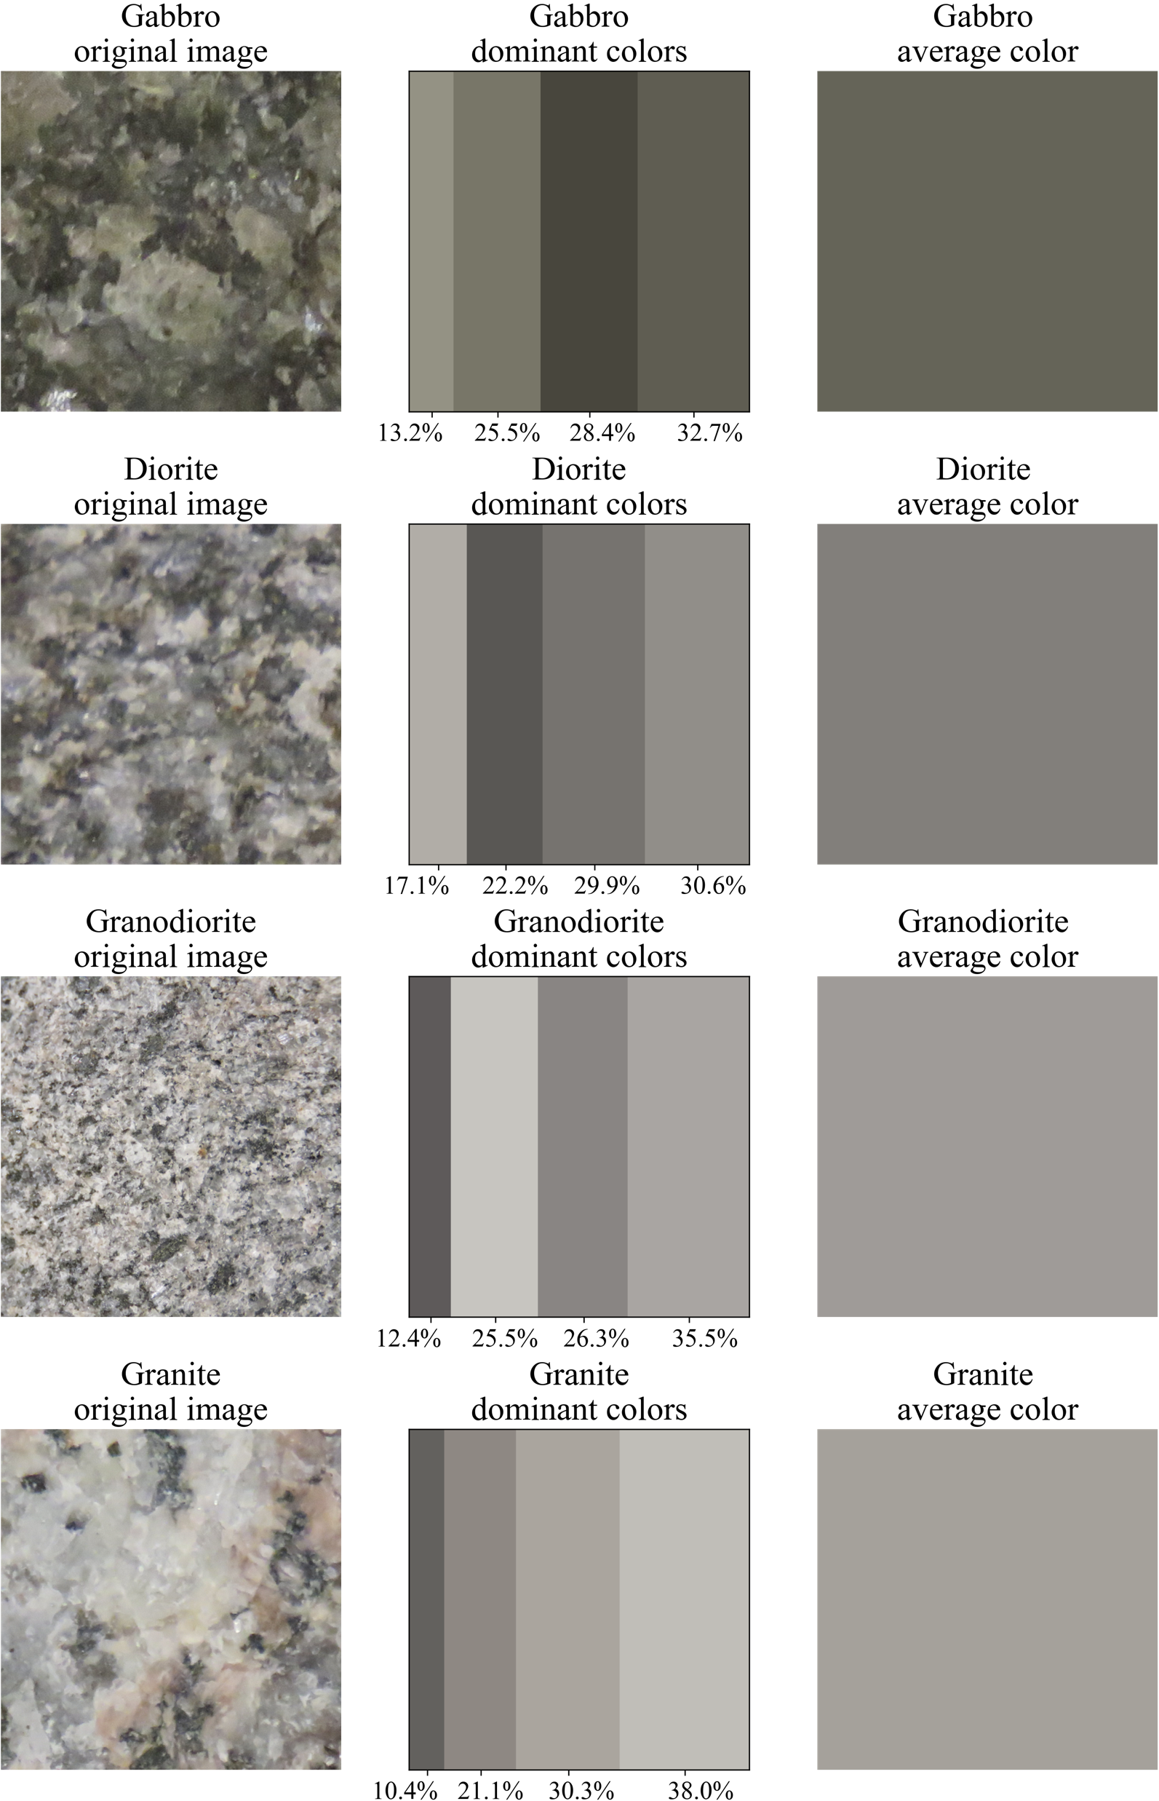

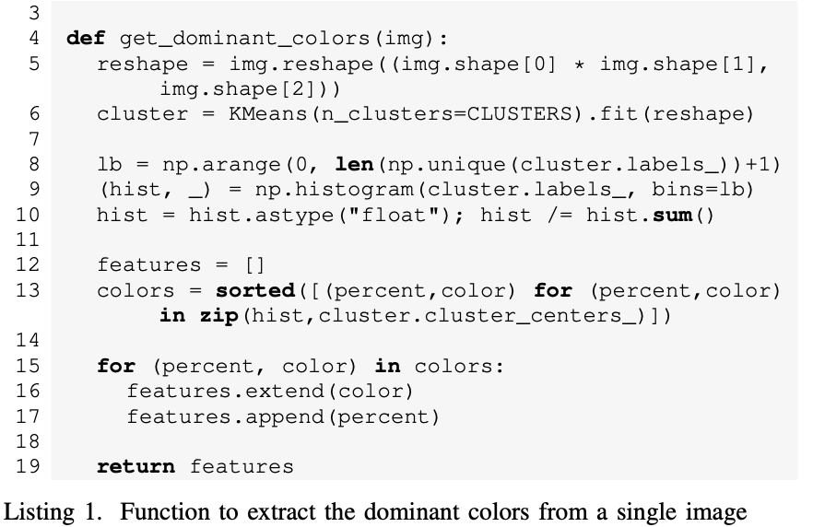
Results - Methodology
4. Color extraction
The K-means algorithm was used to extract the dominant colors from the images.

Slide 18

Results - Methodology
5. Data normalization and label encoding
In this step, the images were processed in order to obtain the color values of the image pixels in RGB and CIELAB color spaces.

Slide 19
Results
Results
The images of plutonic rocks were provided by the Department of Earth and Biological Sciences at Loma Linda University. We use pictures from plutonic rocks that were classified by using petrography and chemistry data.

Slide 20
Results
Discussion
A machine learning model trained with just the dominant colors extracted from gabbro, diorite, granodiorite, and granite images can provide an effective way to classify these plutonic rocks.

Slide 21

Conclusions &
Future Work

Slide 22

OLDMEAD SECONDARY SCHOOL
THANK YOU!
USE THIS SPACE FOR ANNOUNCEMENTS,
HOMEWORKS, OR WAYS STUDENTS CAN APPROACH
YOU IF EVER THEY HAVE QUESTIONS.
SCIENCE CLASS
PAGE 15

Slide 23





















OLDMEAD SECONDARY SCHOOL
FREE ILLUSTRATION RESOURCES
USE THESE FREE RECOLORABLE ICONS AND ILLUSTRATIONS IN YOUR CANVA DESIGN
SCIENCE CLASS
PAGE 20

